Slide 2
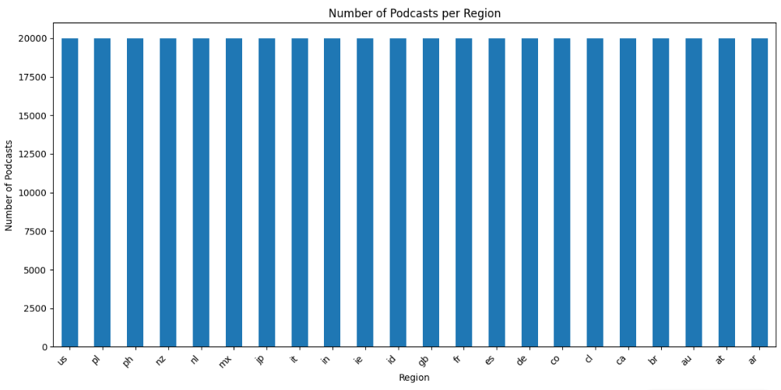
In this data set we have many podcasts’s data such as its region, language, duration, title and description.

Slide 3
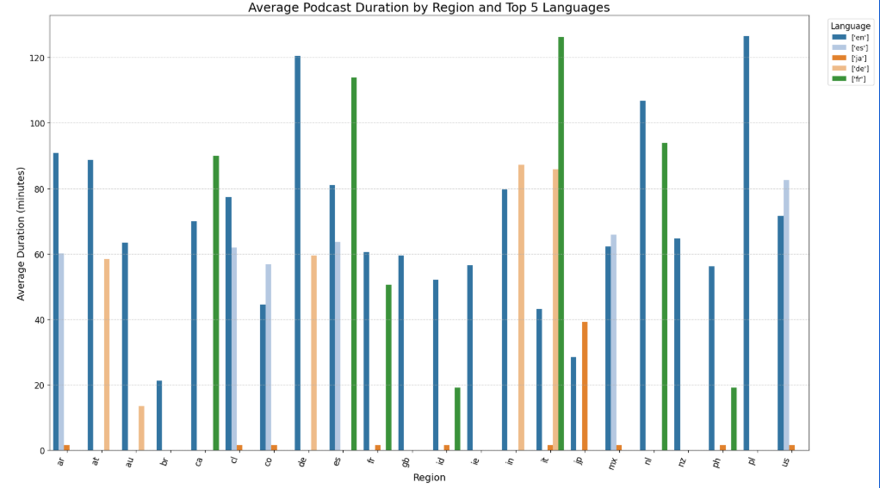
To make a better visualisation I selected just this 5 languages

Slide 4
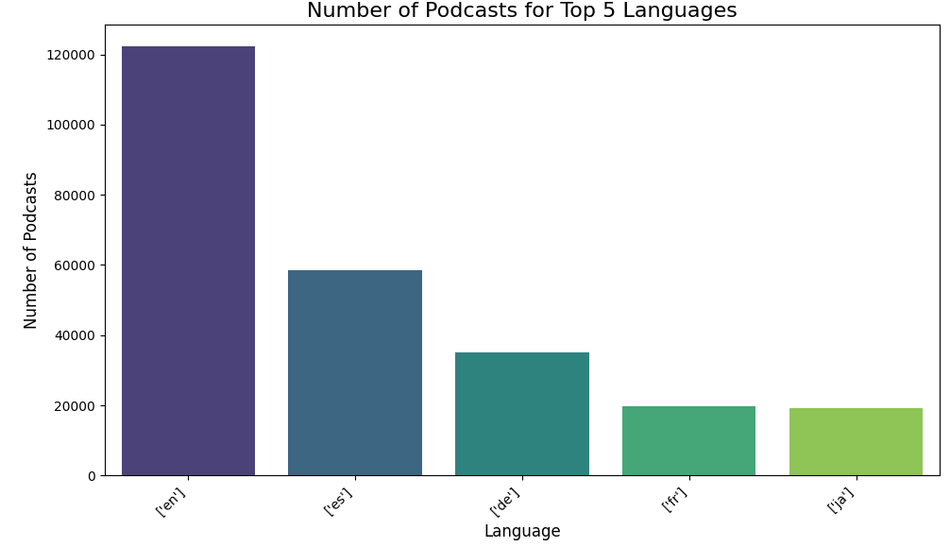
Even though japanese is in top 5 languages in terms of number of podcast but it is not top five in average duration

Slide 5
